Slide 1
SOEN 384
Management, Measurement and Quality Control http://users.encs.concordia.ca/~s384_2/
Lecture 11
Management Key Area (KA) 1: Initiation and scope definition
Functional Size Measurement & COSMIC
COSMIC Measurement Method ISO 19761
COSMIC Method v4.0 Measurement Manual
Villavicencio & Abran. A framework for education in software measurement Evaluation version - 08/2013

Slide 2
Agenda
Review
How to measure size? Functional Size Measurement with COSMIC
Exercises
Next?
SOEN384-F15-L11: FSM

Slide 3
Initiation and Scope Definition
Deals with the decision to embark on a software engineering project
1.1. Determination and Negotiation of Requirements
1.2. Feasibility Analysis
1.3. Process for the Review and Revision of Requirements
soen384-F15-L10: Scope
Notes:
Given the inevitability of change, stakeholders
should agree on the means by which requirements
and scope are to be reviewed and revised (for
example, change management procedures, iterative
cycle retrospectives). This clearly implies
that scope and requirements will not be “set in
stone” but can and should be revisited at predetermined
points as the project unfolds (for example,
at the time when backlog priorities are created or
at milestone reviews). If changes are accepted,
then some form of traceability analysis and risk
analysis should be used to ascertain the impact
of those changes

Slide 4
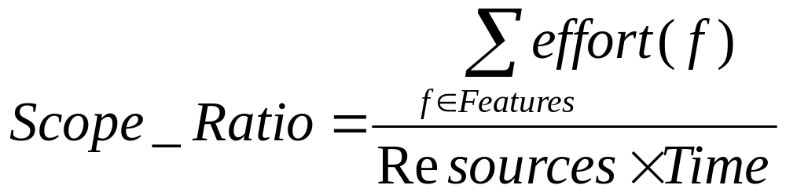
Resources (R)
Scope
Boundary
Time (T)
Features
soen384-F15-L10: Scope

Slide 5
Simple Effort Estimation Techniques
Individual expert judgment is by far the most common estimation approach used in practice (Jørgensen 2002)
Estimation by Analogy: Estimate new projects by comparing them to similar past projects, preferably decomposing the estimate
  What’s estimated:
      Size, Effort, Schedule, Features
Proxy-Based Estimates (next)
Expected Case = [Best Case + (4* Most Likely Case) + Worst Case] / 6
soen384-F15-L10: Scope

Slide 6
Proxy-Based Estimates
Targets whole-project or whole-iteration size estimates
Use t-shirt sizing to help no technical stakeholders rule features in or out while the project is in the wide part of the Cone of Uncertainty.
soen384-F15-L10: Scope
Notes:
1.it's difficult to directly estimate how many test cases your project will need, how many defects to expect, how many classes you'll end up with, and so on.
2. A family of estimation techniques known as proxy-based techniques helps to overcome these challenges. In proxy-based estimation, you first identify a proxy that is correlated with what you really
want to estimate and that is easier to estimate or count (or available earlier in the project) than the quantity you're ultimately interested in.

Slide 7
Proxy-Based Estimates :
T-Shirt Sizing
Supports early-in-the-project decision-making by the nontechnical stakeholders to rule out features
Apply in a project’s early stages (the wide part of the Cone of Uncertainty)
  Identify the features
  Classify the features’ size relative to other features as Small, Medium, Large, or Extra Large
  Let the stakeholders prioritize each feature’s Business Value as Small, Medium, Large, or Extra Large
  Analyze the results
    “If the cost of Feature B is Large but its business value is small, rule it out”
soen384-F15-L10: Scope
Notes:
1.Nontechnical stakeholders often want (and need) to make decisions about project scope during the wide part of the Cone of Uncertainty. A good estimator will refuse to provide highly precise estimates while the project is still in the wide part of the Cone. Sales and marketing staff will say, "How can I know whether I want that feature if I don't know how much it costs?" And a good estimator will say, "I can't tell you what it will cost until we've done more detailed requirements work." It would appear that the two groups are at an impasse.
2.This impasse can be broken by realizing that the goal of software estimation is not pinpoint accuracy but estimates that are accurate enough to support effective project control. In this case, nontechnical stakeholders are typically not asking for an estimate in staff hours. They are asking whether a specific feature is a mouse, rabbit, dog, or elephant. This observation leads to a very useful estimation approach called t-shirt sizing .
Creating this sort of relationship between business value and development cost allows the nontechnical stakeholder to say things like, "If the cost of Feature B is Large, I don't want it, because the value is only Small."

Slide 8
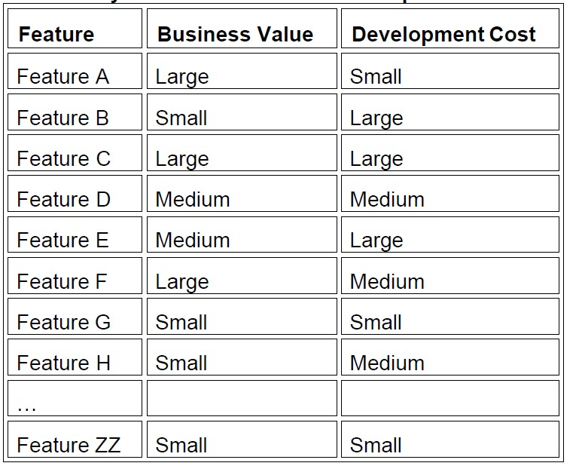
Example of Using T-Shirt Sizing to Classify Features by Business Value and Development Cost
soen384-F15-L10: Scope

Slide 9
Team Effort Estimate for a Project
(apply this soen390/490)
Have each team member estimate pieces of the project individually, and then meet to compare estimates
Discuss the differences among the individual results
Average your estimates
Arrive at a consensus estimate E that the whole group accepts
Calculate a range of effort estimation values:
  At the beginning of the project the range is approximately within +- 25%
  [min, max]: min = [E * 75%, E * 125%]
  When the project advances the range is within +- 15% [min, max]: min = [E * 85%, E * 115%]
Why the effort range is wider at the beginning of the project?
soen384-F15-L10: Scope

Slide 10
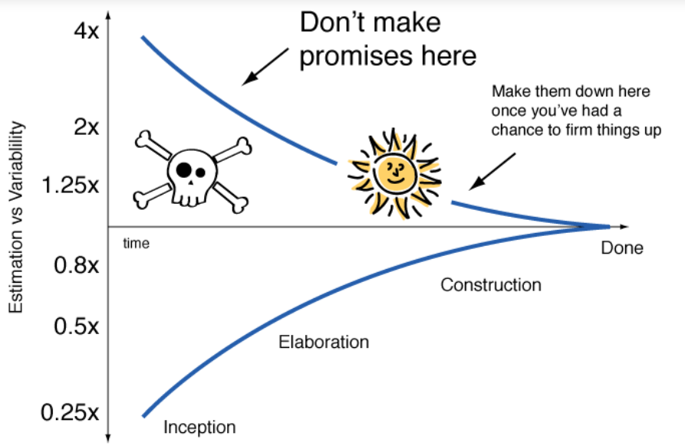
[“it is better to be roughly right
than precisely wrong”]
Use historical values
Run an iteration
Make a forecast
Use ranges
  Example:
  Estimated effort is 20 person-month
  The estimated effort is in the range
  [0.85x15p-m, 1.15x15p-m] =
  [17p-m, 23p-m]
soen384-F15-L10: Scope
Notes:
, the range of uncertainty in effort estimation is initially
much larger, and decreases with accumulated problem and solution knowledge
within a Cone of Uncertainty to determine a feasible product scope to ensure a timely delivery.

Slide 11
Sample (soen390)
Use the Feature Estimated Effort to calculate individual task effort:
Task Effort =
Feature Estimated Effort * Average task% from previous projects
Average task% from previous projects
Features | tasks | Actual Effort | Estimated effort
Feature 1 | Feature 1 tasks |  | Effort_F1
 | Management |  | Effort_F1*10%
 | Requirements |  | Effort_F1*15%
 | Design |  | Effort_F1*15%
 | Implementation |  | Effort_F1*40%
 | Quality Control |  | Effort_F1*20%
Feature 2 | Feature 2 tasks |  | Effort_F2
...
soen384-F15-L10: Scope

Slide 12
Reference
The primary purpose of software estimation is not to predict a project’s outcome; it is to determine whether a project’s targets are realistic enough to allow the project to be controlled to meet them.
—Steve McConnell, Software Estimation: Demystifying the Black Art
soen384-F15-L10: Scope

Slide 13
Key points: Why Cost Estimation?
Planning new development work (schedule, effort, cost, people)
Estimating how many features you can deliver within a specific development iteration
expected effort range required for each feature
Estimating number of developers
Estimating time needed for defect correction work (maintenance)
…
SOEN384-L17: Effort

Slide 14
More Complex Approach to Cost Estimation
  Combines measures taken from existing products with historical and environmental data to determine likely amount of resources required to build a product of perform an activity (may be related to the same or different projects)
  Example : functional size of project requirements can be combined with historical and environmental data for similar projects to estimate the effort needed to develop the functionality of this project
Independent variable
?
How?
dependent variable
EFFORT = a * SIZE + c
SOEN384-L17: Effort

Slide 15
Agenda
Review
How to measure size? Functional Size Measurement with COSMIC
Exercises
Next?
SOEN384-F15-L11: FSM

Slide 16
Views on Software Size
Length: “How many …?”
  Physical size of the product static counts of various element types (classes, methods, lines of code, etc.)
  Hold over relatively long intervals of time
Functionality: the amount of function delivered by the product, from a given point of view
SOEN384-F15-L11: FSM

Slide 17
Functional Size Measurement (FSM)
What is functional size?
Examples of FUR are:
  input of students data in a registration system;
  calculate the average mark of students in a course;
  list the students that are above the average.
Functional size is defined in ISO 14143-1:2007(E) as:
"a size of the software derived by quantifying the Functional User Requirements (FUR)," where FUR is as "a sub-set of the User Requirements describing what the software shall do, in terms of tasks and services"
SOEN384-F15-L11: FSM
©2013 Villavicencio & Abran

Slide 18
Functional Size Measurement (FSM)
What is functional size measurement?
The current functional size measurement (FSM) methods:
  ISO 19761:2011 COSMIC functional size measurement method
  ISO 20926:2009 IFPUG 4.1 functional size measurement method
  ISO 24570:2005 NESMA functional size measurement method
  ISO 20968:2002 MKII function point analysis
  ISO 29881:2010 FiSMA 1.1 functional size measurement method
"Functional Size Measurement (FSM) is a technique used to measure the size of software by quantifying the Functional User Requirements of the software"
SOEN384-F15-L11: FSM
©2013 Villavicencio & Abran

Slide 19
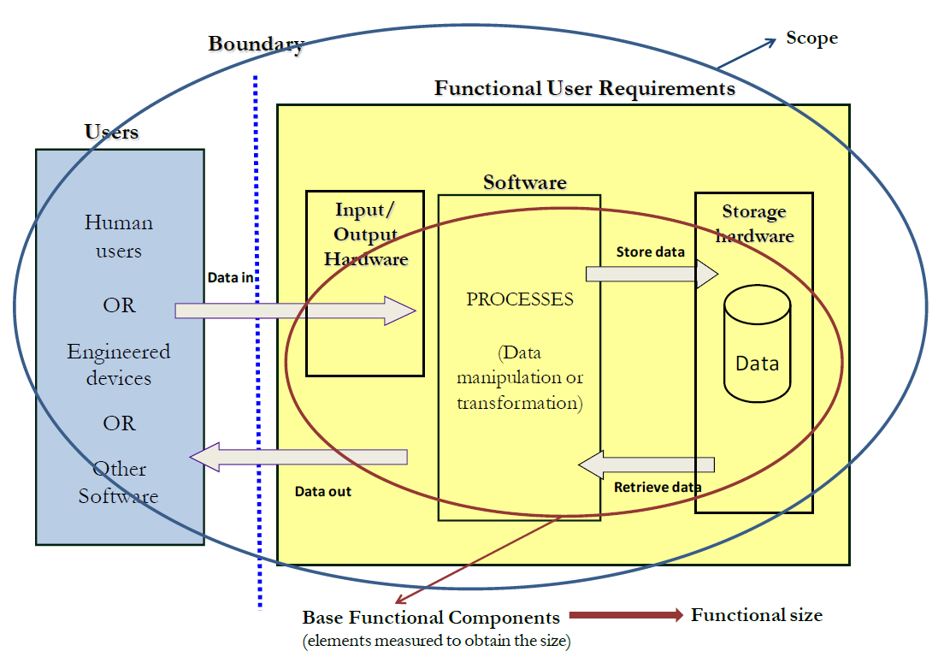

Functional size measurement methods: general representation [ISO 14143-1:2007]
SOEN384-F15-L11: FSM
©2013 Villavicencio & Abran

Slide 20
History of Software Functional Size
Next
MkII FPA 1.3
COSMIC – ISO 19761
MkII FPA
NESMA
IFPUG 4.1
IFPUG 4.0
Allan Albrecht FPA
1980 1985 1990 1995 2000
SOEN384-F15-L11: FSM

Slide 21
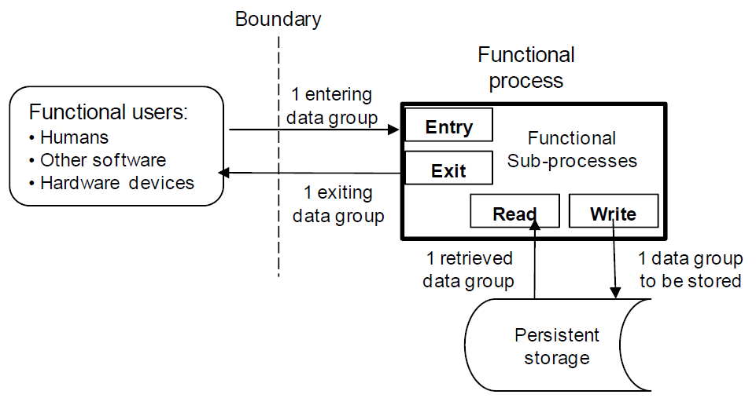
COSMIC FSM Standard
(ISO/IEC 19761)
SOEN384-F14-L11: Scope. COSMIC
Notes:
System is viewed as a black-box, with its programming logic and data manipulations hidden from the users.

Slide 22
COSMIC functional process
A functional process is an elementary component of a set of Functional User Requirements, comprising a unique, cohesive and independently executable set of data movements.
SOEN384-F14-L11: Scope. COSMIC

Slide 23
Example
Apply COSMIC measurement procedure to measure “A – B”:
The user enters the values A and B of the operands
The system in return displays the result
SOEN384-F15-L11: FSM

Slide 24

COSMIC for A-B
Boundary
A and B (‘ENTRY’)
DATA
MANIPULATION
( A – B)
USER
RESULT (‘EXIT’)
SOEN384-F15-L11: FSM

Slide 25
Aggregate the Measurement Results
FP Size = Sum(Ne ) + Sum(Nx ) + Sum(Nr ) + Sum(Mw )
Where:
  Ne = number of Entries
  Nx = number of Exits
  Nr = number of Reads
  Mw = number of Writes
there is no upper limit to the functional size of the functional requirements
Min size: 2 CFP
SOEN384-F15-L11: FSM

Slide 26
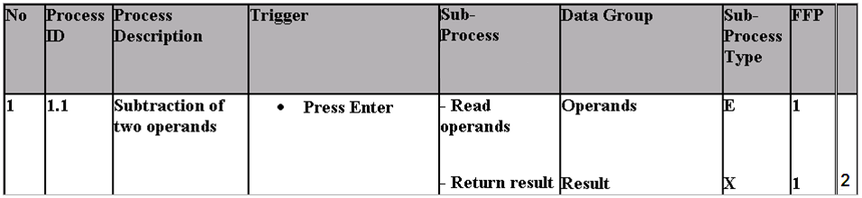
Exercise 1 Solution
Total = 2 CFP
SOEN384-F15-L11: FSM

Slide 27
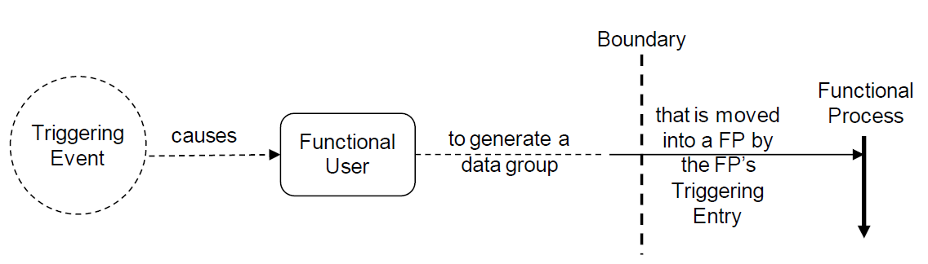
Triggering events and functional processes: Examples
EXAMPLE 1: In a company, an order is received (triggering event), causing an employee (functional user) to enter the order data (triggering Entry conveying data about the object of interest ‘order’), as the first data movement of the ‘order entry’ functional process.
SOEN384-F14-L11: Scope. COSMIC
Notes:
Research has shown that performing functional size measurement itself can be helpful in detecting
defects in software artifacts, by revealing omissions or inconsistencies in functional processes that are difficult to detect with regular audit procedures

Slide 28
Example of one Functional Process - Exercise CFP1
“Create a list of sales territories"
1 -This use case starts when the user enters the sales territories’ codes and names.
2 - The system saves the sales territories.
3 - The system displays a confirmation message or, if it fails to save the territories, it issues an error message.
SOEN384-F15-L11: FSM

Slide 29
The COSMIC method http://www.cosmicon.com/
1. The Basic Functional Component (BFC) is the data movement.
2. The measurement unit is a COSMIC Function Point (CFP), which represents one data movement.
3. A functional user of a software application can be: a human, another software application, or a hardware device.
4. A boundary is a conceptual interface between the functional users and the software application.
5. The functional users interact with the software application via data movements.
6. There are four types of data movements: Entry (E), eXit (X), Read (R), and Write (W).
©2013 Villavicencio & Abran
SOEN384-F15-L11: FSM

Slide 30
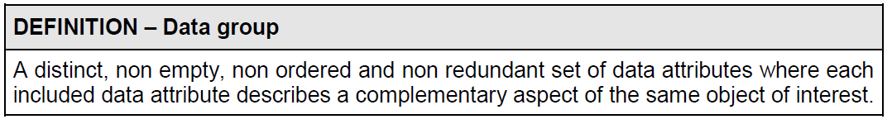
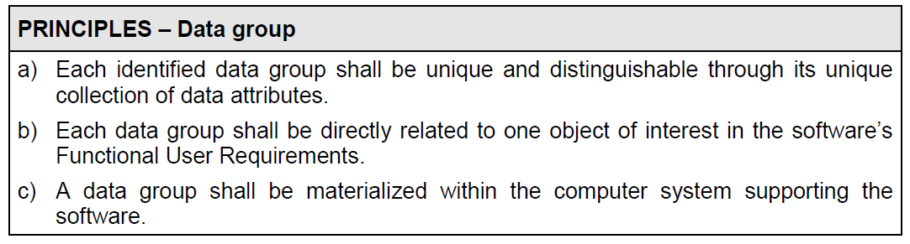
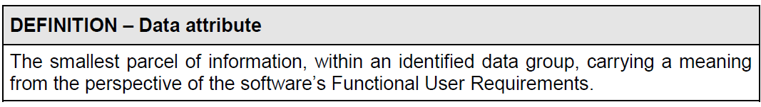
Data groups & data attributes
SOEN384-F14-L11: Scope. COSMIC

Slide 31
functional processes & data movements
Each functional process:
  is independently executable
  triggered by an event
  Contains all that is required to be done in response to the triggering event
Data movement types: E, X, R, W
Entry type : considered to include certain associated data manipulations such as validation of the entered data
  Triggering events are Entry type
  Clock and timing events are Triggering events
Each data movement moves data belonging to a single data group
  data movement “de-duplication”
SOEN384-F15-L11: FSM

Slide 32
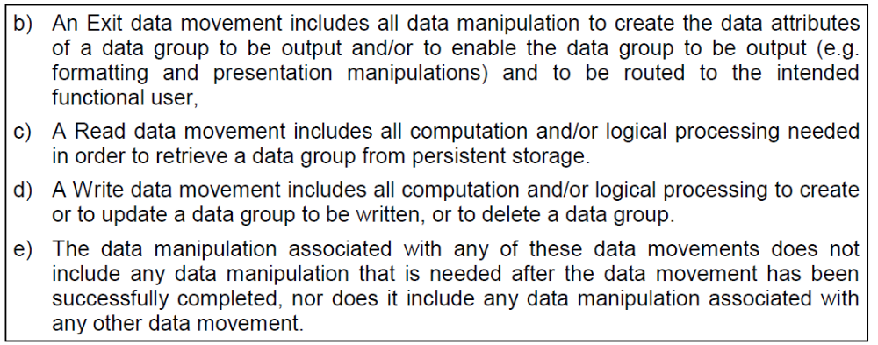
Data manipulation associated with data movements
SOEN384-F15-L11: FSM

Slide 33
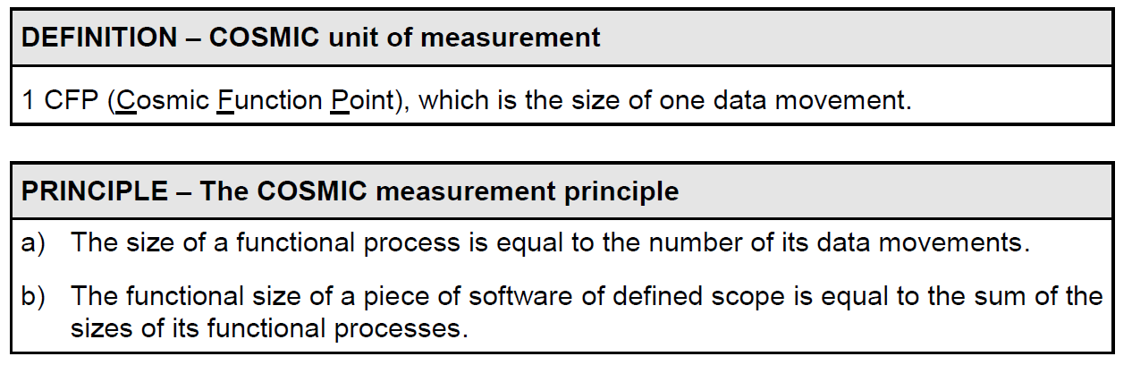
Measurement Units
Each data movement
  Is Counted only once within a functional process
  Does not involve another data movement type
SOEN384-F15-L11: FSM

Slide 34
COSMIC measurement procedure
1. Identify the functional users
2. Identify the triggering events
3. Identify the functional processes enabled by those events
4. Identify the data groups
5. Identify the data movements from the interface (Entry, eXit, Read and Write)
6. Obtain the total number of Cosmic Function Points (CFP)
SOEN384-F15-L11: FSM

Slide 35
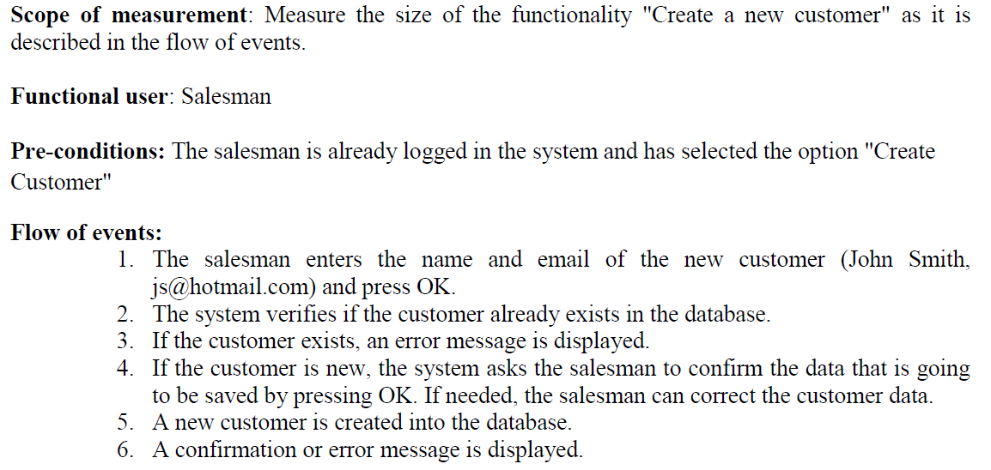
More Complex Exercise CFP2
SOEN384-F15-L11: FSM
©2013 Villavicencio & Abran

Slide 36
Exercise CFP2: Hints
Functional processes:
  Verify if the customer exists in the database,
  Create a new customer in the database.
Data group (DG):
Customer
  Data attributes:
    Name, email
System messages
SOEN384-F15-L11: FSM
©2013 Villavicencio & Abran

Slide 37
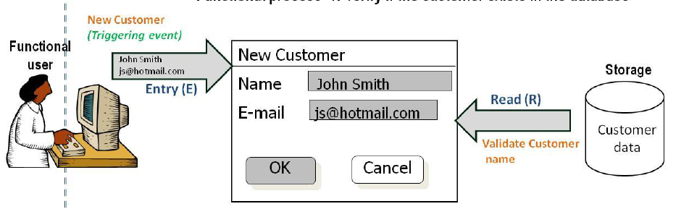
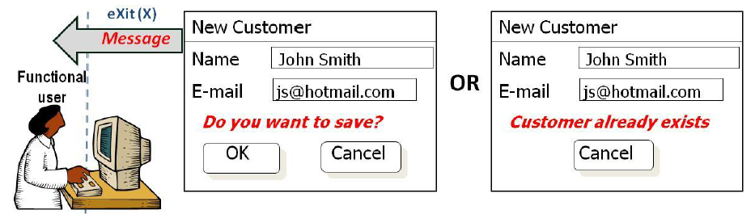
Exercise CFP2: Verify if the customer exit in the database
SOEN384-F15-L11: FSM
©2013 Villavicencio & Abran

Slide 38
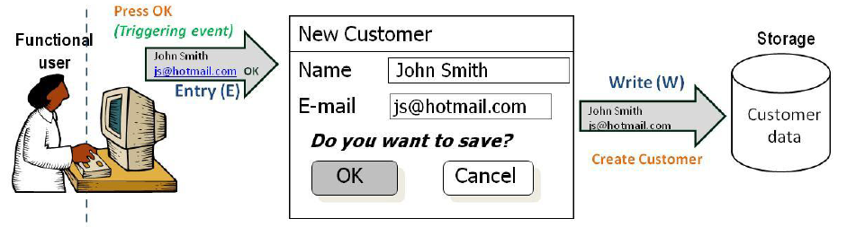
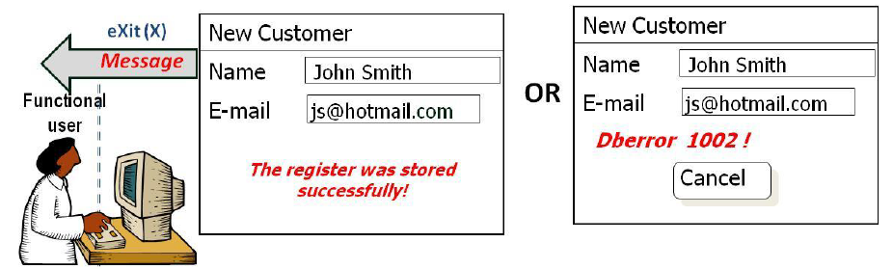
Exercise CFP2: confirm customer data and save
SOEN384-F15-L11: FSM

Slide 39
Rule - data movement “de-duplication” (identify data movements, not occurrences)
A data movement of a given type (E, X, R, W) moving a Data Group is in general identified only once in the Functional Process
Example1: the developer decides to implement a Read of a data group by two commands to retrieve different subsets of data attributes of the same Object of interest from persistent storage at different points in the Functional Process.
For sizing purposes, we identify only one Read.
Example2: suppose a Read is required in the FUR that in practice requires many retrieval occurrences, as in a search through a file.
For sizing purposes, we identify only one Read
SOEN384-F15-L11: FSM
Notes:
Repeat a Read before the process ceases in order to check that the data have not changed since the first Read in the same process.

Slide 40
Rule - data movement “de-duplication” (identify data movements, not occurrences)
A data movement of a given type (E, X, R, W) moving any Data Group is in general identified only once in the Functional Process
Exception: if two Read of the same data type require different data manipulation, then the Read should be identified twice in the one Functional Process
Example: Repeat a Read before the process ceases in order to check that the data have not changed since the first Read in the same process.
SOEN384-F15-L11: FSM

Slide 41
More examples: CRUD transactions
[C = Create, R = Read, U = Update and D = Delete]
Will be discussed in the tutorial this Friday
SOEN384-F15-L11: FSM

Slide 42
Applicability of COSMIC functional size measurement method
Business application software
Real-time software
Hybrids of the above
SOEN384-F15-L11: FSM

Slide 43
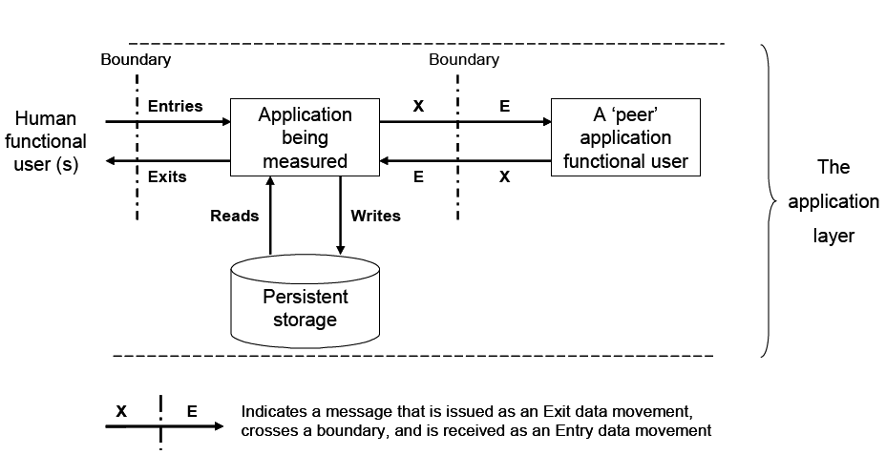
COSMIC: Logical View on Business Application
(all previous examples belong to this category)
SOEN384-F15-L11: FSM

Slide 44
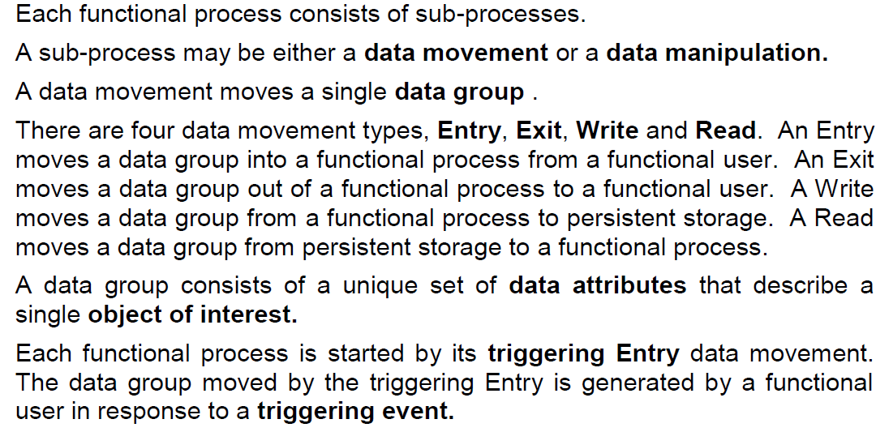
Principles of the COSMIC FSM (1)
SOEN384-F15-L11: FSM

Slide 45
Principles of the COSMIC FSM (2)
a) Software is bounded by hardware.
b) Software is typically structured into layers.
c) A layer may contain one or more separate ‘peer’ pieces of software.
d) Any piece of software to be measured, shall be defined by its measurement scope, which shall be confined wholly within a single layer.
SOEN384-F15-L11: FSM

Slide 46
More on COSMIC
Research has shown that performing functional size measurement itself can be helpful in detecting defects in software artifacts, by revealing omissions or inconsistencies in functional processes that are difficult to detect with regular audit procedures
SOEN384-F15-L11: FSM

Slide 47
Questions?
...
SOEN384-F15-L11: FSM

Slide 48
Next?
Lecture: how to use COSMIC for effort estimation?
Tutorial on COSMIC method (exercises)
TODO: Read COSMIC Measurement Method ISO 19761
SOEN384-F15-L11: FSM

